Slide 1
A Personalized Travel Planning And Tracking App
-M.PRAVEENA
712822104040

Slide 2
DESCRIPTION
Planning a trip has never been easier or more tailored to you. Wanderlust is a smart, intuitive travel app designed to help you plan, organize, and track your journeys in a way that’s as unique as you are. Whether you’re dreaming of a weekend getaway or a month-long adventure, Wanderlust offers everything you need to make your travel experience seamless, exciting, and fully personalized.
Custom Itinerary Builder: Effortlessly plan your trip day-by-day with our drag-and-drop itinerary builder. Choose destinations, activities, and accommodations based on your interests, and the app will suggest the best options to suit your preferences.
Smart Trip Tracker: Stay on top of your trip with real-time tracking. Log flights, bookings, and expenses in one place. Receive notifications for any changes or reminders, so you never miss a moment of your journey.
Expense & Budget Tracker: Keep an eye on your spending with built-in tools to set a budget and track costs. Get insights into where your money is going so you can stay within budget or splurge on a special experience.
Travel Journal & Memories: Capture memories along the way with photos, notes, and reviews of the places you've visited. Create a digital journal of your adventures, which you can share with friends or look back on long after the trip is over.

Slide 3
Main Activity.java:
Package com.example.travelapp Import android.content.Context
Import android.content.Intent Import android.os.Bundle
Import androidx.activity.ComponentActivity
Import androidx.activity.compose.setContent
Import androidx.compose.foundation.Image
Import androidx.compose.foundation.clickable
Import androidx.compose.foundation.layout.*
Import androidx.compose.foundation.rememberScrollState
Import androidx.compose.foundation.verticalScroll
Import androidx.compose.material.Card
Import androidx.compose.material.Text
Import androidx.compose.runtime.Composable
Import androidx.compose.ui.Alignment
Import androidx.compose.ui.Modifier
Import androidx.compose.ui.draw.scale
Import androidx.compose.ui.graphics.Color
Import androidx.compose.ui.res.painterResource
Import androidx.compose.ui.res.stringResource

Slide 4
Import androidx.compose.ui.text.font.FontFamily
Import androidx.compose.ui.text.font.FontWeight
Import androidx.compose.ui.text.style.TextAlign
Import androidx.compose.ui.unit.dp
Import androidx.compose.ui.unit.sp
Class MainActivity : ComponentActivity() {
Override fun onCreate(savedInstanceState: Bundle?) { Super.onCreate(savedInstanceState)
setContent {
TravelApp(this)
}
}
@Composable
Fun TravelApp(context: Context) {
Column(
Modifier = Modifier
.padding(20.dp)
.verticalScroll(rememberScrollState())
) {
Text(
fontSize = 40.sp,
color = Color(android.graphics.Color.rgb(120, 40, 251)),
fontFamily = FontFamily.Cursive,
text = “Wanderlust Travel”
)

Slide 5
Spacer(modifier = Modifier.height(20.dp))
// 01
Card(
Modifier = Modifier
.fillMaxWidth()
.height(250.dp)
.clickable {
Context.startActivity(
Intent(context, BaliActivity::class.java)
)
},
Elevation = 8.dp
)
{
Column(
horizontalAlignment = Alignment.CenterHorizontally
){
Image(
painterResource(id = R.drawable.bali), contentDescription = “”,
modifier = Modifier
.height(150.dp)
.scale(scaleX = 1.2F, scaleY = 1F)
)

Slide 6
Text(
Text = stringResource(id = R.string.place_1),
fontSize = 18.sp
)
Text(
Text = stringResource(id = R.string.description),
fontWeight = FontWeight.Light,
fontSize = 16.sp,
textAlign = TextAlign.Center,
)
Text(
Text = stringResource(id = R.string.plan), color = Color.Gray,
fontSize = 16.sp
)
}
}
Spacer(modifier = Modifier.height(20.dp))
//02
Card(

Slide 7
Modifier = Modifier
.fillMaxWidth()
.height(250.dp)
.clickable {
Context.startActivity(
Intent(context, ParisActivity::class.java)
)
},
Elevation = 8.dp
)
{
Column(
horizontalAlignment = Alignment.CenterHorizontally
) {
Image(
painterResource(id = R.drawable.paris),contentDescription = “”,
modifier = Modifier
.height(150.dp)
.scale(scaleX = 1.2F, scaleY = 1F)
)
Text(
Text = stringResource(id = R.string.place_2),
fontSize = 18.sp )

Slide 8
Text(
Text = stringResource(id = R.string.description),
fontWeight = FontWeight.Light,
fontSize = 16.sp,
textAlign = TextAlign.Center,
)
Text(
Text = stringResource(id = R.string.plan),color = Color.Gray,
fontSize = 16.sp
)
}
}
Spacer(modifier = Modifier.height(20.dp))
//03
Card(
Modifier = Modifier
.fillMaxWidth()
.height(250.dp)
.clickable {
Context.startActivity(
Intent(context, SingaporeActivity::class.java)

Slide 9
)
},
Elevation = 8.dp
)
{
Column(
horizontalAlignment = Alignment.CenterHorizontally
) {
Image(
painterResource(id = R.drawable.singapore), contentDescription = “”,
modifier = Modifier
.height(150.dp)
.scale(scaleX = 1.2F, scaleY = 1F)
)
Text(
Text = stringResource(id = R.string.place_3),
fontSize = 18.sp
)
Text(
Text = stringResource(id = R.string.description),
fontWeight = FontWeight.Light,
fontSize = 16.sp,

Slide 10
textAlign = TextAlign.Center,
)
Text(
Text = stringResource(id = R.string.plan), color = Color.Gray,
fontSize = 16.sp
)
}
}
Spacer(modifier = Modifier.height(20.dp))
}
}
}

Slide 11
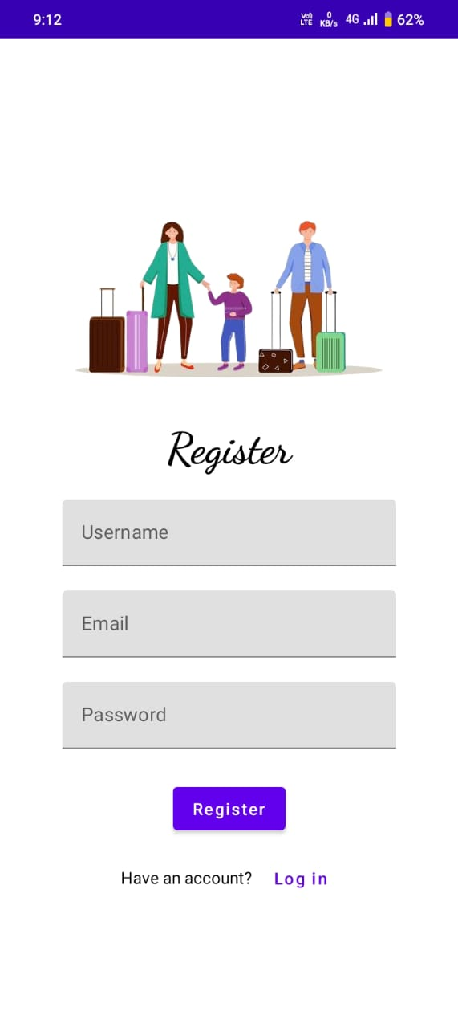
OUTPUT:

Slide 12
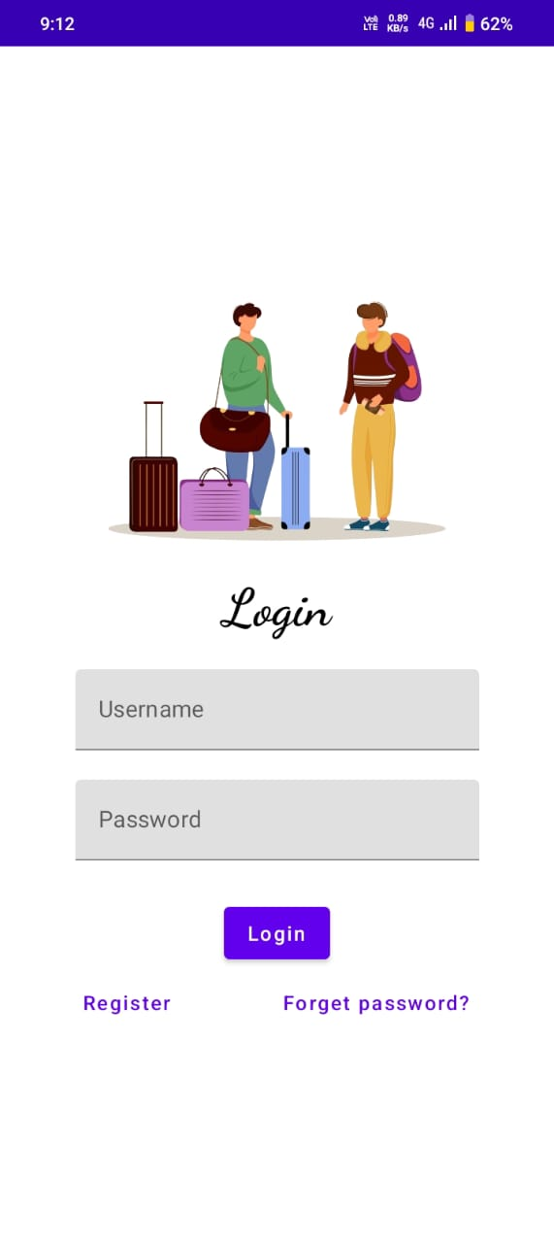

Slide 13
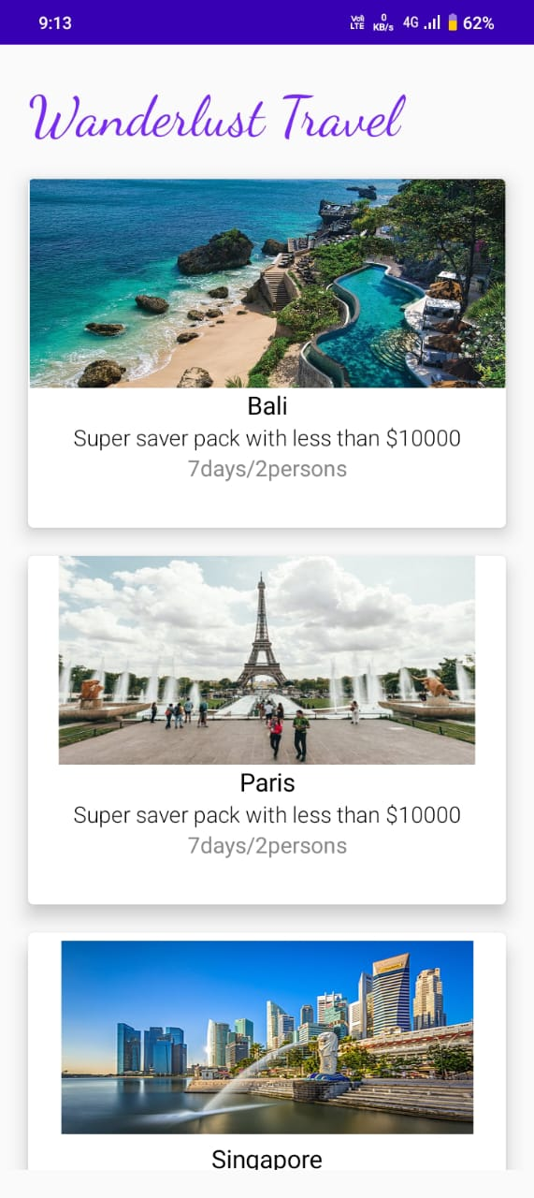

Slide 14
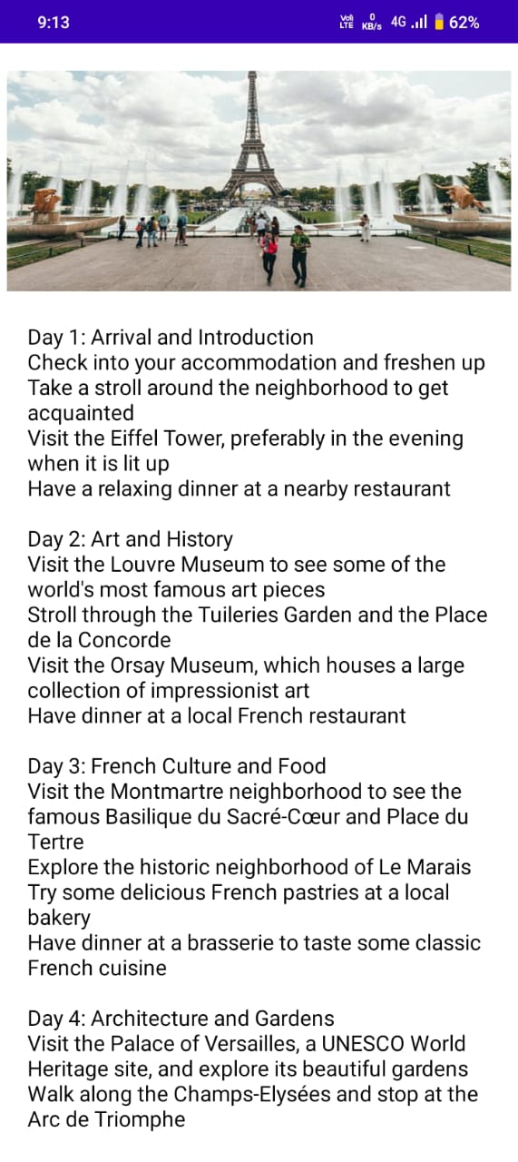

Slide 15
